Slide 1

GME Meeting: Scholarship and Faculty Development Needs
Brandy L. Close, M.Ed.
Director of Curricular Affairs, Instructional Design, and Academic Technologies
Department of Medical Education
Oklahoma State University Center for Health Sciences
College of Osteopathic Medicine

Slide 2
Defining Scholarly Activity in GME
Grady EC, Roise A, Barr D, et al. Defining scholarly activity in graduate medical education. J Grad Med Educ 2012;4: 558e561.
In 2011, Residency Review Committees (RRCs) issued 402 citations for scholarly activity
No standard definition of scholarly activity relevant across specialties and institutions
No uniform way to assess scholarly activity of faculty and residents

Slide 3
4 Components of Scholarship
Boyer, Ernest L., et al. Scholarship reconsidered: Priorities of the professoriate. John Wiley & Sons, 2015.
Discovery- advancing knowledge
Integration- synthesizing knowledge
Application- applying existing knowledge
Teaching- disseminating current medical knowledge

Slide 4
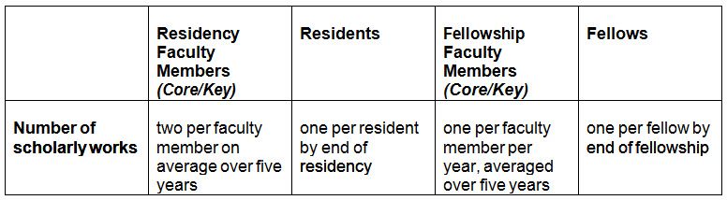
Scholarly Activity Guidelines
Faculty members, fellows, and residents are expected to document scholarly productivity at the minimum frequencies: (Family Med)

Slide 5
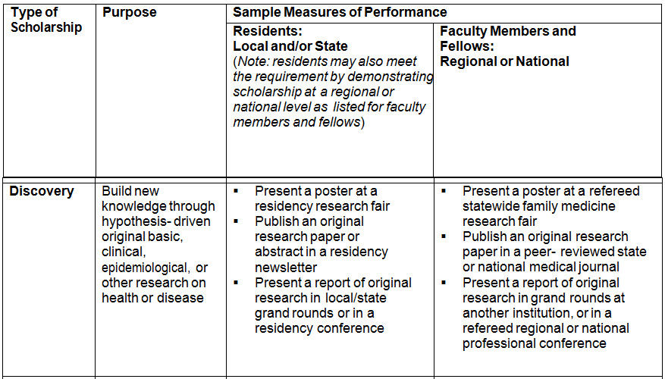
Scholarly Activity Rubric

Slide 6
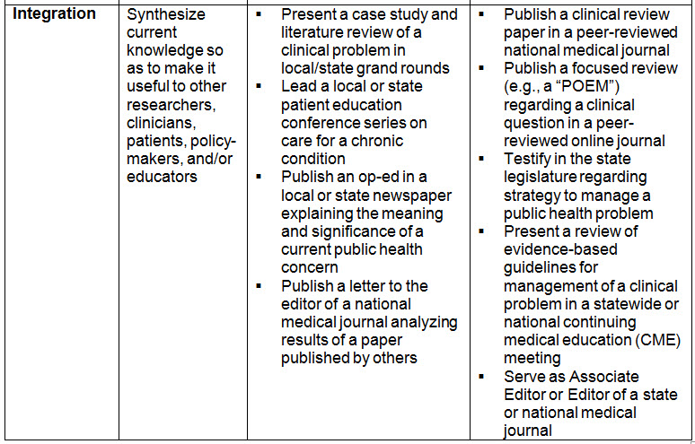

Slide 7
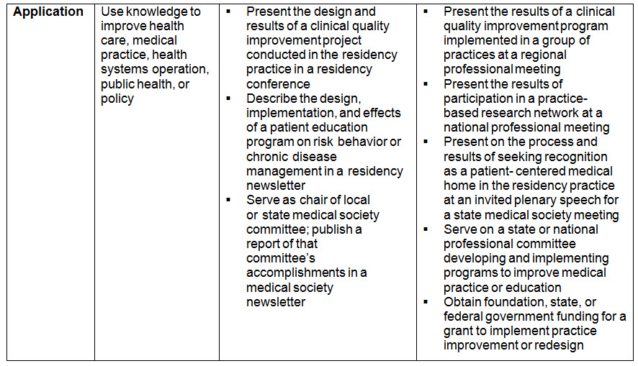

Slide 8
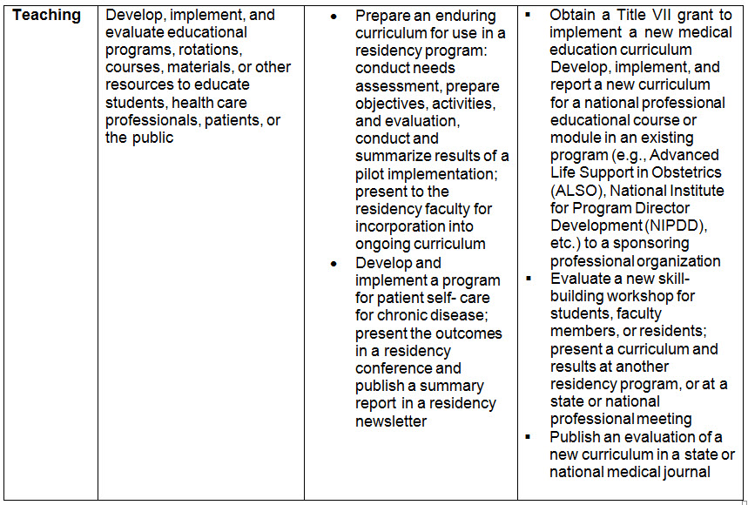

Slide 9

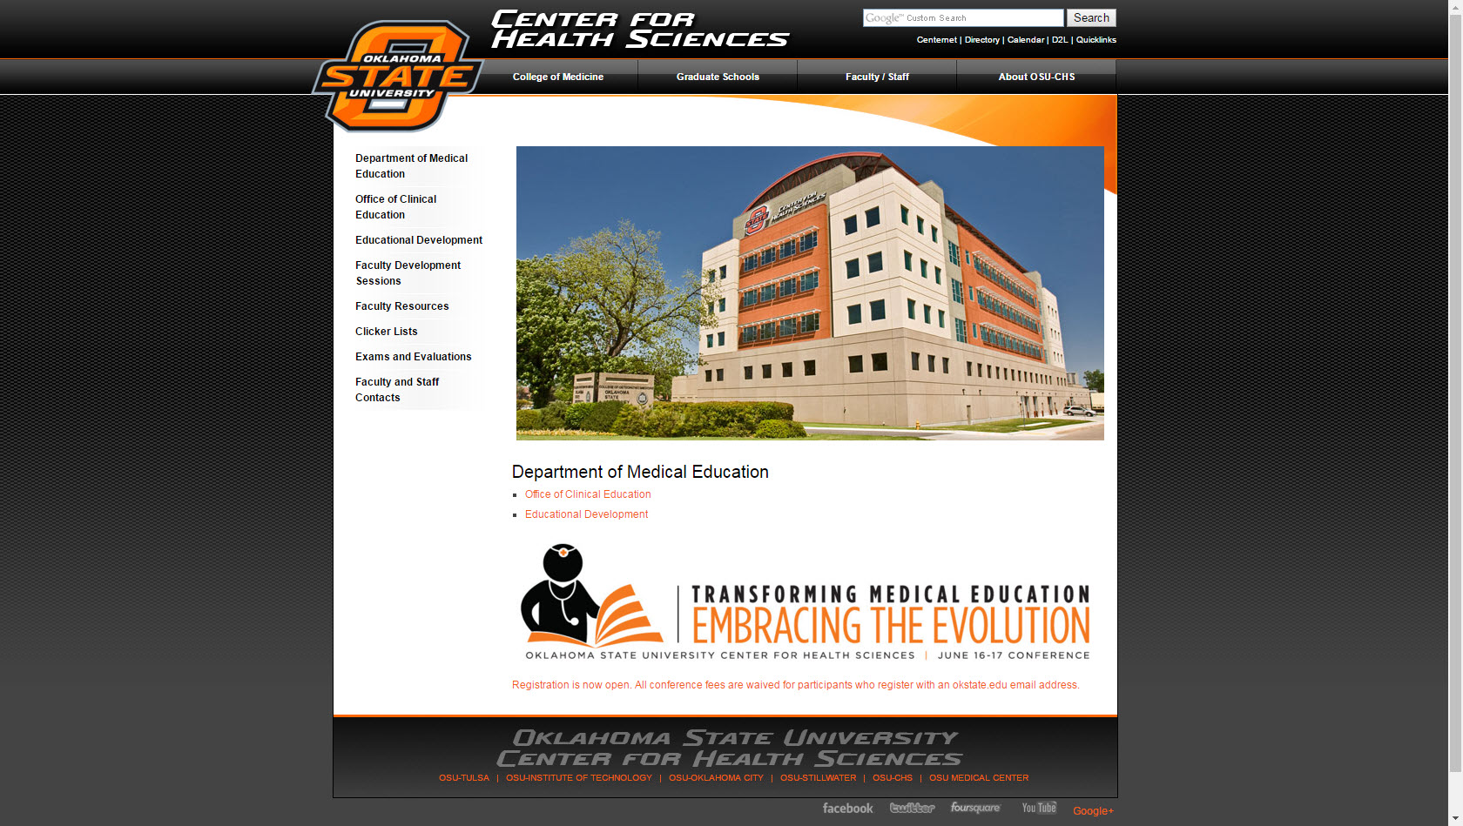
GME Faculty Development and Research Resources

Slide 10

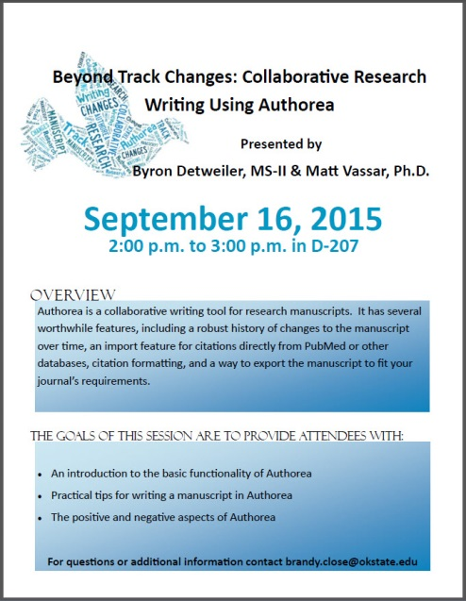
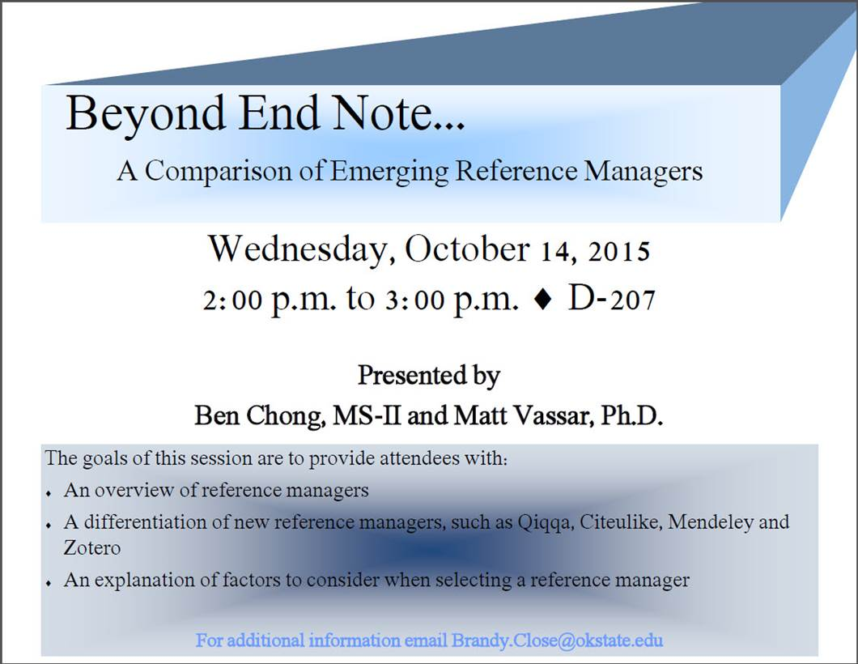
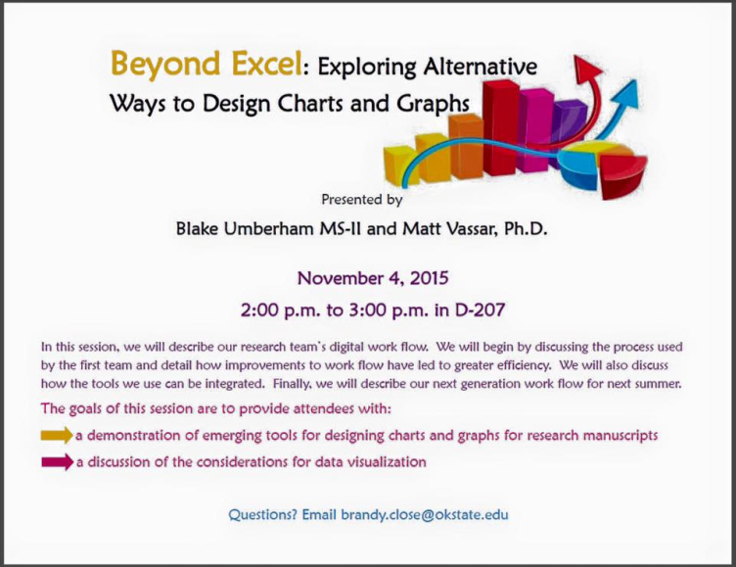
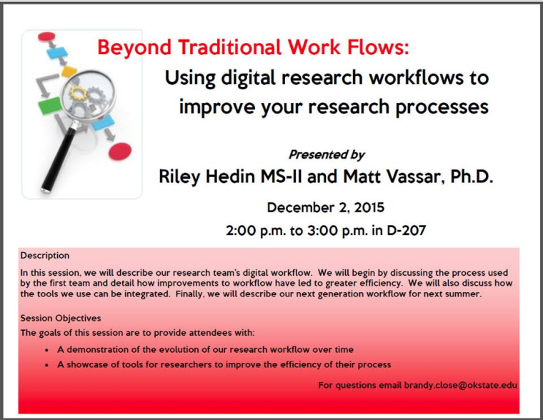
Scholarly Research Faculty Development Series (Fall 2015)

Slide 11
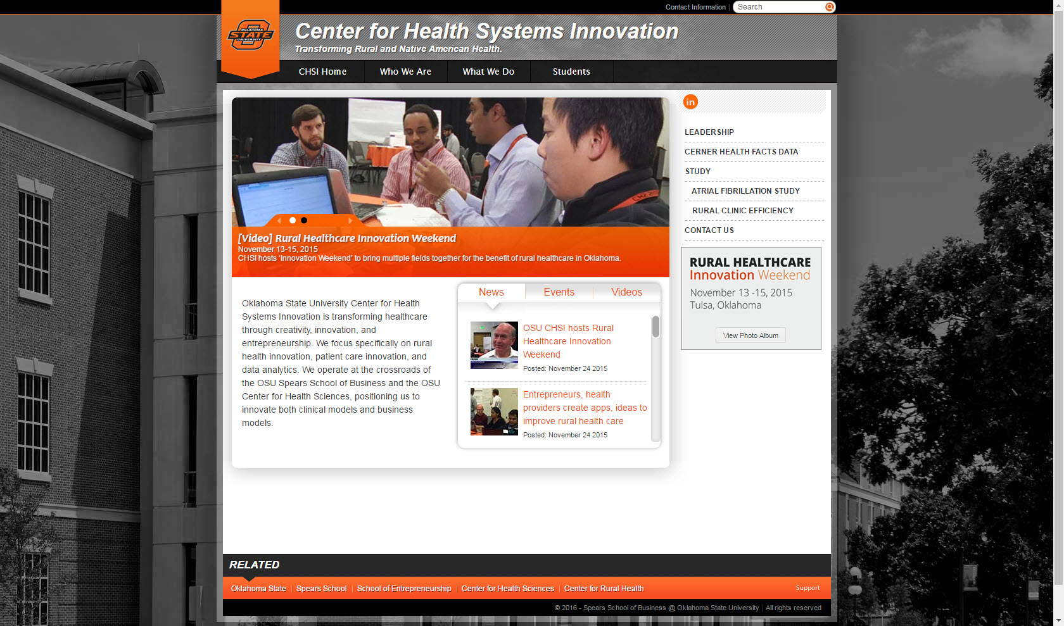
Center for Health Systems Innovation

Slide 12

OSU-CHS Medical Education Conference (NOT Medsation)

Slide 13
What Do You Need?
Teaching Skills Faculty Needs Survey
Research Skills Faculty Needs Survey
- Journal List
GME Faculty Development Day for CME: A Teaching Skills Symposium

Slide 14
Questions??

